Slide 1
Introduction
SE110PHP:
Laravel 10.0
Notes:
20778C
1: Introduction to Self-Service BI Solutions

Slide 2
Course Supporting Site
https://phpcourses.azurewebsites.net/

Slide 3
Your Instructor
LENG Chee Kong
ckleng1964@gmail.com
0192133329

Slide 4
Training Schedule
Duration: 5 Days Training Hours: 9am~5pm Lunch Break:
Monday ~ Thursday: 12:30pm~1:30pm (1 Hour)
Friday: 12:30pm~2:30pm (2 Hours)
Short Breaks:
Morning: 10:30am~10:45am
Afternoon: 3:30pm~3:45pm
Notes:
20778C
1: Introduction to Self-Service BI Solutions

Slide 5
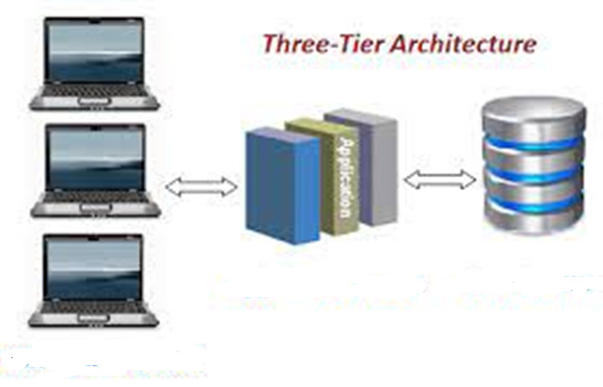
3-Tier Architecture
Business Logic
Persistency
Presentation

Slide 6
3-Tier Architecture (JEE)
Glashfish+JSP+Servlet
MySQL
Browsers

Slide 7
3-Tier Architecture (.NET)
IIS+ASP.NET+C#
SQL Server
Browsers

Slide 8
3-Tier Architecture (PHP)
Apache+PHP
MySQL
Browsers

Slide 9
3-Tier Architecture (Our Lab Setup)
XAMPP
Apache+PHP
+
Visual Studio Code
MySQL
Browsers

Slide 10
What is PHP?
The PHP Hypertext Preprocessor (PHP) is a programming language that allows web developers to create dynamic content that interacts with databases.
PHP is basically used for developing web-based software applications.
This course helps you to build your base with PHP
Notes:
20778C
1: Introduction to Self-Service BI Solutions

Slide 11
Common uses of PHP
PHP performs system functions, i.e. from files on a system it can create, open, read, write, and close them.
PHP can handle forms, i.e. gather data from files, save data to a file, through email you can send data, return data to the user.
You add, delete, modify elements within your database through PHP.
Access cookies variables and set cookies.
Using PHP, you can restrict users to access some pages of your website.
It can encrypt data.
Notes:
20778C
1: Introduction to Self-Service BI Solutions

Slide 12
Characteristics of PHP
Simplicity
Efficiency
Security
Flexibility
Familiarity

